Slide 1
The Purchaser’s Guide to Supplier Consolidation
View this presentation in full screen for the best experience.

Slide 2
Introduction
Thanks for your interest in this guide – hopefully, it’ll answer some of your main questions about supplier consolidation.
I’ve worked with lots of purchasers over the course of my career, and in my opinion, the key things you need to know are:
The benefits of supplier consolidation
The possible approaches to consolidation you can take
How consolidation works in practice
The potential drawbacks, and the solutions you need to overcome them.
Let’s get started.
Slawomir Bieszk
Slawomir is currently the Customer Unit Director at Bufab Poland and has a great deal of experience in the C-parts industry, both in purchasing and sales.
slawomir.bieszk@bufab.com

Slide 3
Three Benefits of Supplier Consolidation

Slide 4
Benefits of Supplier Consolidation
Reduced Administration
The most noticeable benefit of a consolidated supplier base for a purchaser is the lower levels of administration.
When you have a large number of suppliers, you need to:
Source parts
Negotiate prices
Place orders
Pay invoices
Receive deliveries
…for each individual supplier.
By reducing the number of suppliers you deal with, you eliminate a lot of repeated manual work – giving you time to focus on other things.

Slide 5
Benefits of Supplier Consolidation
Better Relationships
If you place a lot of small orders with a large number of suppliers, it’s hard to build up a good working relationship with them.
It’s unlikely you have the time to really get to know each supplier – and on their side, they may not be willing to spend the time developing a relationship with a fairly small customer.
A situation like this can lead to:
Slower communication
Higher purchase prices for C-parts
Longer waits to solve problems
After consolidating, you’ll have more time to grow a better working relationship with each supplier, and they’ll see your company as a more significant customer. Over time, this can mean better pricing and clearer communication.

Slide 6
Benefits of Supplier Consolidation
Improved Manufacturing
Downtime is a huge problem for any manufacturing operation. Even a short period of downtime can be hugely expensive, so it’s vital to avoid at all costs.
Downtime can be caused by machine breakdowns or human error – but it’s common that a shortage of C-parts can stop the production line.
When you work with too many suppliers, it’s hard to keep your ongoing orders and deliveries under control.
If this situation gets out of hand, the factory can find itself without C-parts – and the blame for the resulting downtime lands on the purchaser’s shoulders.
By consolidating your suppliers, you can gain a better overview of the flow of C-parts into your operation and avoid unexpected parts shortages from occurring.

Slide 7
Three Approaches to Supplier Consolidation

Slide 8
Which Approach is Best?
If you’re planning on consolidating your suppliers, there’s a few approaches you can take.
Partial consolidation
Full consolidation
Vendor-managed inventory (VMI)
For several reasons, you might not be willing to let one supplier handle all your C-parts. In this case, you can partially consolidate.
For example, this could involve switching to one supplier for the most common C-parts, but leaving the more complex or uncommon parts in the hands of multiple suppliers.
With this approach, you switch to a single supplier who takes care of all your C-parts needs.
You have a single point of contact, and the ordering, delivery and payment processes are all streamlined.
Here, your C-parts supplier becomes totally responsible for managing your internal C-parts inventory.
They can provide you with tools and software for keeping track of stock, and VMI solutions often allow for automatic ordering once parts stocks drop below a certain level.
Choose the Logistics Solution that fits your needs the best, from full VMI to a basic scanner solution.

Slide 9
How Does Supplier Consolidation Work in Practice?

Slide 10
The Consolidation Process
Initiation
Information
Analysis
Evaluation
Business case
Feedback
Quotation and contract
Implementation
A typical supplier consolidation looks like this – from the initial analysis of the operation, to the implementation and follow up. Let’s look at each step in more detail.
Initiation
In this stage, the consolidation process begins – either through contact with one of your existing suppliers, or an entirely new one.

Slide 11
The Consolidation Process
Initiation
Information
Analysis
Evaluation
Business case
Feedback
Quotation and contract
Implementation
A typical supplier consolidation looks like this – from the initial analysis of the operation, to the implementation and follow up. Let’s look at each step in more detail.
Information
Now, the supplier starts getting some basic information about your current C-parts operation and learns more about your desired future state.

Slide 12
The Consolidation Process
Initiation
Information
Analysis
Evaluation
Business case
Feedback
Quotation and contract
Implementation
A typical supplier consolidation looks like this – from the initial analysis of the operation, to the implementation and follow up. Let’s look at each step in more detail.
Analysis
In this stage, a more detailed analysis of your C-parts operation is made by the supplier – they look at things like the types of parts you need, how many you use and at what rate, and the key performance indicators that their consolidated solution needs to achieve.

Slide 13
The Consolidation Process
Initiation
Information
Analysis
Evaluation
Business case
Feedback
Quotation and contract
Implementation
A typical supplier consolidation looks like this – from the initial analysis of the operation, to the implementation and follow up. Let’s look at each step in more detail.
Business case
For the consolidated approach to be feasible, there needs to be a solid business case. In this stage, your supplier should be able to show you the clear, concrete business benefits of making the switch and handing over more of your C-parts needs to them.

Slide 14
The Consolidation Process
Initiation
Information
Analysis
Evaluation
Business case
Feedback
Quotation and contract
Implementation
A typical supplier consolidation looks like this – from the initial analysis of the operation, to the implementation and follow up. Let’s look at each step in more detail.
Feedback
Now, you have the opportunity to use your knowledge of your operation to suggest changes to the proposal. It’s possible that one aspect of the recommended approach won’t work for your company – in this stage, you can adapt the consolidation plan so that it works for you.

Slide 15
The Consolidation Process
Initiation
Information
Analysis
Evaluation
Business case
Feedback
Quotation and contract
Implementation
A typical supplier consolidation looks like this – from the initial analysis of the operation, to the implementation and follow up. Let’s look at each step in more detail.
Quotation and contract
After a few rounds of feedback, you should have developed a strategy together that will work - now it's time to set prices and sign
the contract so that the savings work can begin.

Slide 16
The Consolidation Process
Initiation
Information
Analysis
Evaluation
Business case
Feedback
Quotation and contract
Implementation
A typical supplier consolidation looks like this – from the initial analysis of the operation, to the implementation and follow up. Let’s look at each step in more detail.
Implementation
Now, the actual work of implementing the new approach begins. Depending on the complexity of your C-parts needs, some time may be needed for the implementation to take place. You should be able to start noticing the benefits quite early on.

Slide 17
The Consolidation Process
Initiation
Information
Analysis
Evaluation
Business case
Feedback
Quotation and contract
Implementation
A typical supplier consolidation looks like this – from the initial analysis of the operation, to the implementation and follow up. Let’s look at each step in more detail.
Evaluation
Once the new consolidated approach is implemented, it’s time to evaluate. This evaluation might take place some time after the implementation, and the goal is to make the adjustments needed for the process to run as smoothly as possible.
Problems can be identified and fixed here, and unexpected requirements can be added into the solution. After the evaluation, there is a new implementation – and your supplier continues to evaluate the operation as time goes on.

Slide 18
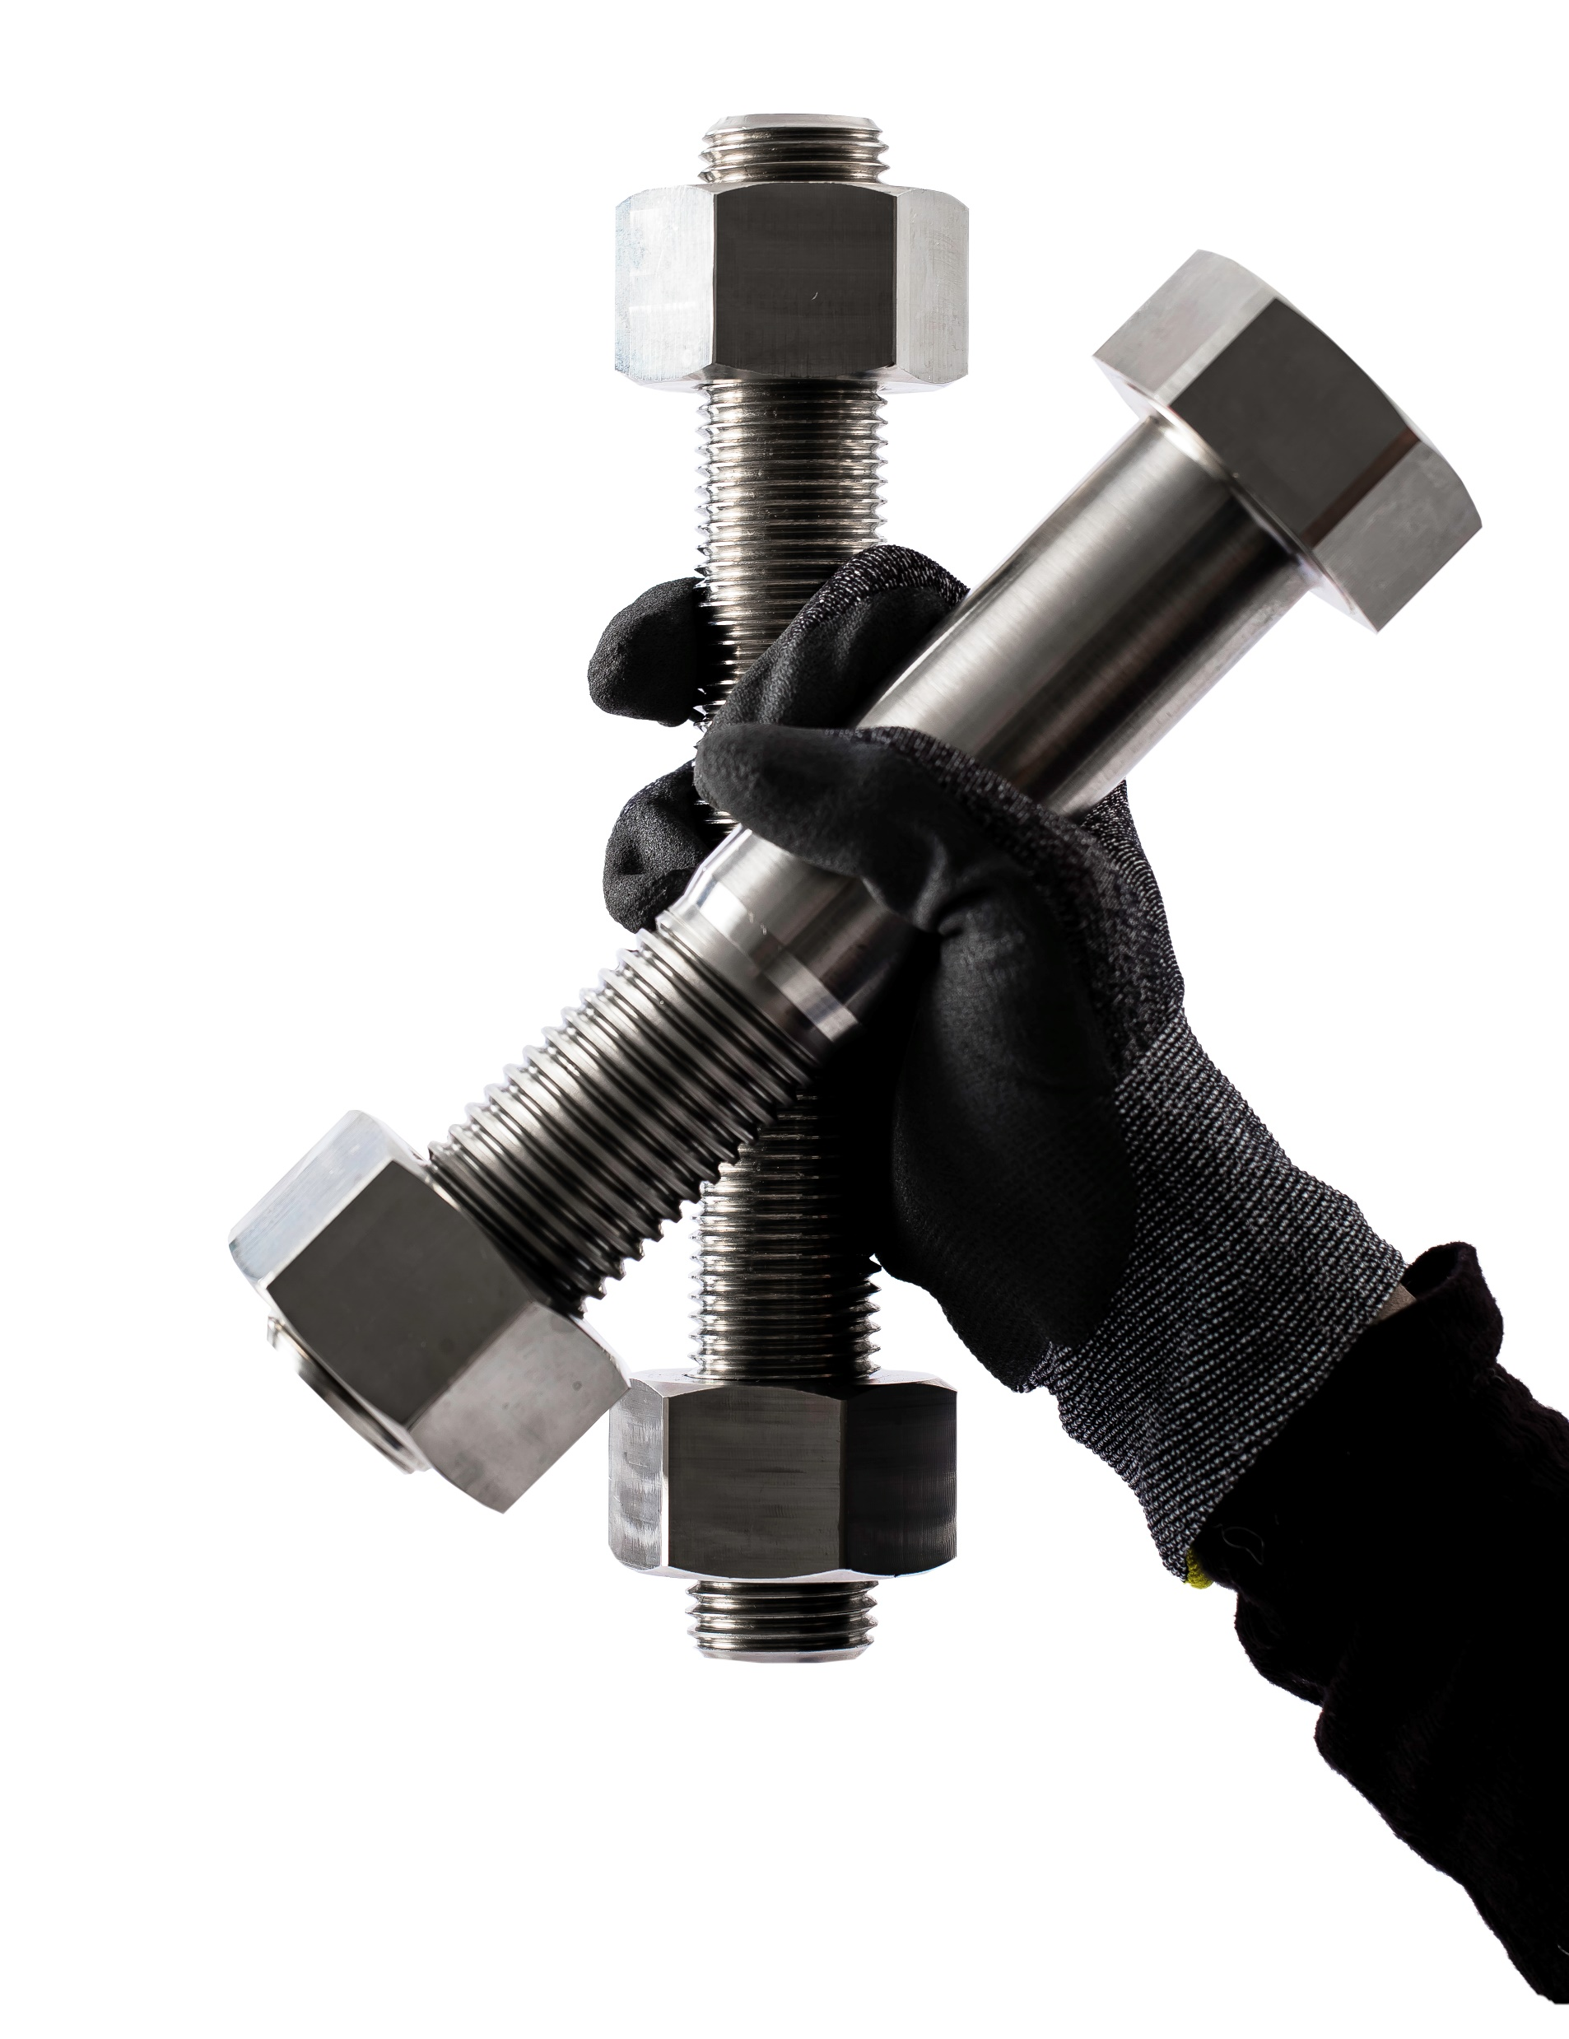
Three Drawbacks of Supplier Consolidation

Slide 19
Issues to Think About
If you work with a large number of suppliers, we’d always recommend consolidation. However, here are some of the drawbacks that many companies are concerned about – and some possible solutions.
Lack of leverage
Secure supply
Difficult handovers
When you have only one supplier, or perhaps only a few, it can be tough to pressure them to give you a better price.
When you have no second supplier to choose from, you don’t have much leverage. The supplier knows they don’t have a competitor who would love to get your business, so they may be less willing to give you discounts or other deals.
The solution
If you choose a smart, trustworthy supplier, they won’t try to make money out of you on relatively low C-parts prices. Instead, they’ll aim to build a relationship and improve your purchasing operation over time – which will result in more significant financial success for both of you in the long run.
Ensuring availability is your most important task as a purchaser. So putting all your eggs in one basket and relying on only one supplier is often seen as risky. If one supplier has issues or can’t get hold of your needed parts, you should be able to go to another, right?
The solution
With the right partner, it’s possible to get the same reliable supply of parts while also enjoying reduced administration, lower costs, and all the other benefits that come with supplier consolidation.
If you choose a larger, reputable C-parts supplier, they will have access to a much bigger change of sub-suppliers than you. By choosing a supplier like this, you outsource the task of ensuring redundancy – giving you a better purchasing experience as well as peace of mind.
Even if your manufacturing operation is relatively small, it’s still filled with complexities. Your products are unique, and a reliable supplier needs to have a good understanding of your needs if your partnership is going to be successful.
It’s this process of gradual optimization that makes many companies hesitate about consolidating suppliers. They realize that they would benefit from consolidation – but the amount of work involved in switching and the potential risk of problems means they put it off.
The solution
Like all improvement measures in a manufacturing company, switching suppliers is major time investment – however, if your supplier base is very spread out, you’ll see a return even in the short term. And you do not have to do it all at once.

Slide 20
Good Luck!
Thanks for reading – hopefully the guide answered your key questions about supplier consolidation.
If you’d like to know more, or if you’re planning on consolidating your supplier base, don’t hesitate to get in touch with us.
Talk to an expert

